Slide 1

CNN Spatial
Optimizations
CRML Lab
The Technion
Inna Batenkov
Ido Imanuel
Supervised by Gil Shomron

Slide 2

Project Goals
Acquire knowledge on CNNs
Build an end-to-end framework for
Cross Neuron Predictions
Develop a prediction mask optimization
scheme
Analyze MAC operation savings on various
networks and datasets

Slide 3
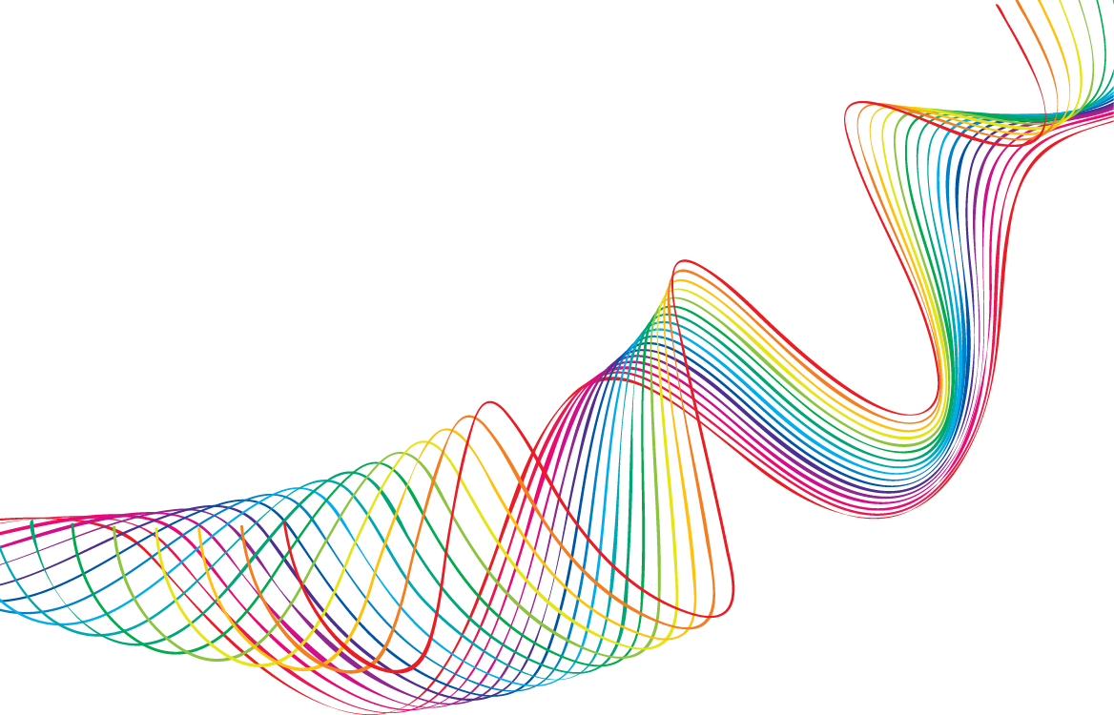
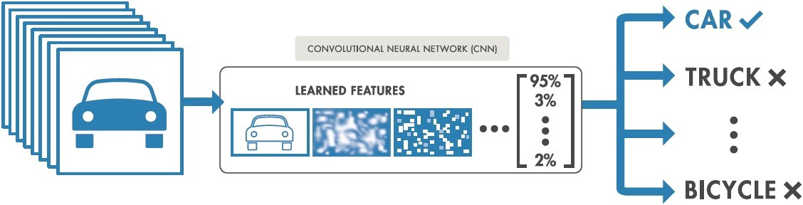
Convolution Nets
Notes:
Present the CNN as a black-box, allowing input of images (RGB or Grey Scale) and outputting a vector of probabilities, classifying each image to a specific class. Present the Forward Pass and the Backward pass as a Feedback system.

Slide 4
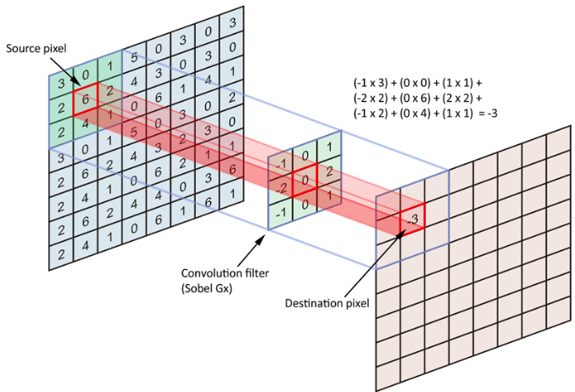

Convolution Nets
Notes:
Present the actual representation of an image as matrix of numbers. Explain the Convlution operator, with the Sobel filter. Talk about replacing the filter with a learned filter of varying weights.

Slide 5
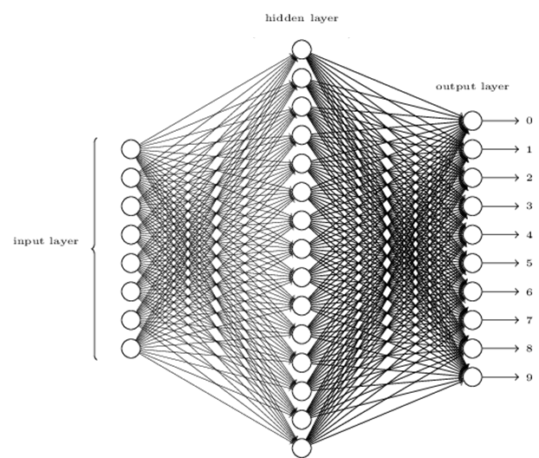

Net Collaterals
Notes:
Talk about the Dense/Fully Connected and Activation roles. Talk about how there are more than just these (Like Dropout/Pooling) – but these suffice for this presentation.

Slide 6
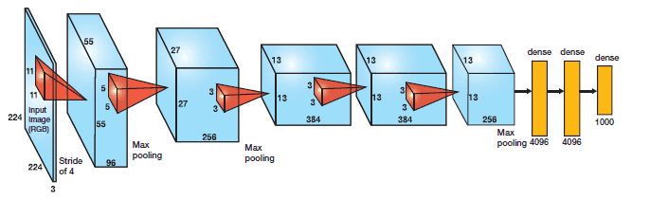
AlexNet - 2012
Notes:
Talk about the AlexNet architecture and the number of filters in each layer. Remind that this DNN won the ImgNet classification contest back in 2012 by a vast amount.

Slide 7

Power Considerations in CNNs
Can we make Machine Learning portable to battery powered mobile devices?
Notes:
Main Research question – How can we reduce power in CNNs?
(1) Smaller DNNs require less communication across servers during distributed training.
(2) Smaller DNNs require less bandwidth to export a new model from the cloud to an autonomous car.
(3) Smaller DNNs are more feasible to deploy on FPGAs and other hardware with limited memory.
Show the demo, and explain about output feature maps and input feature maps and the seriality of the computation.

Slide 8
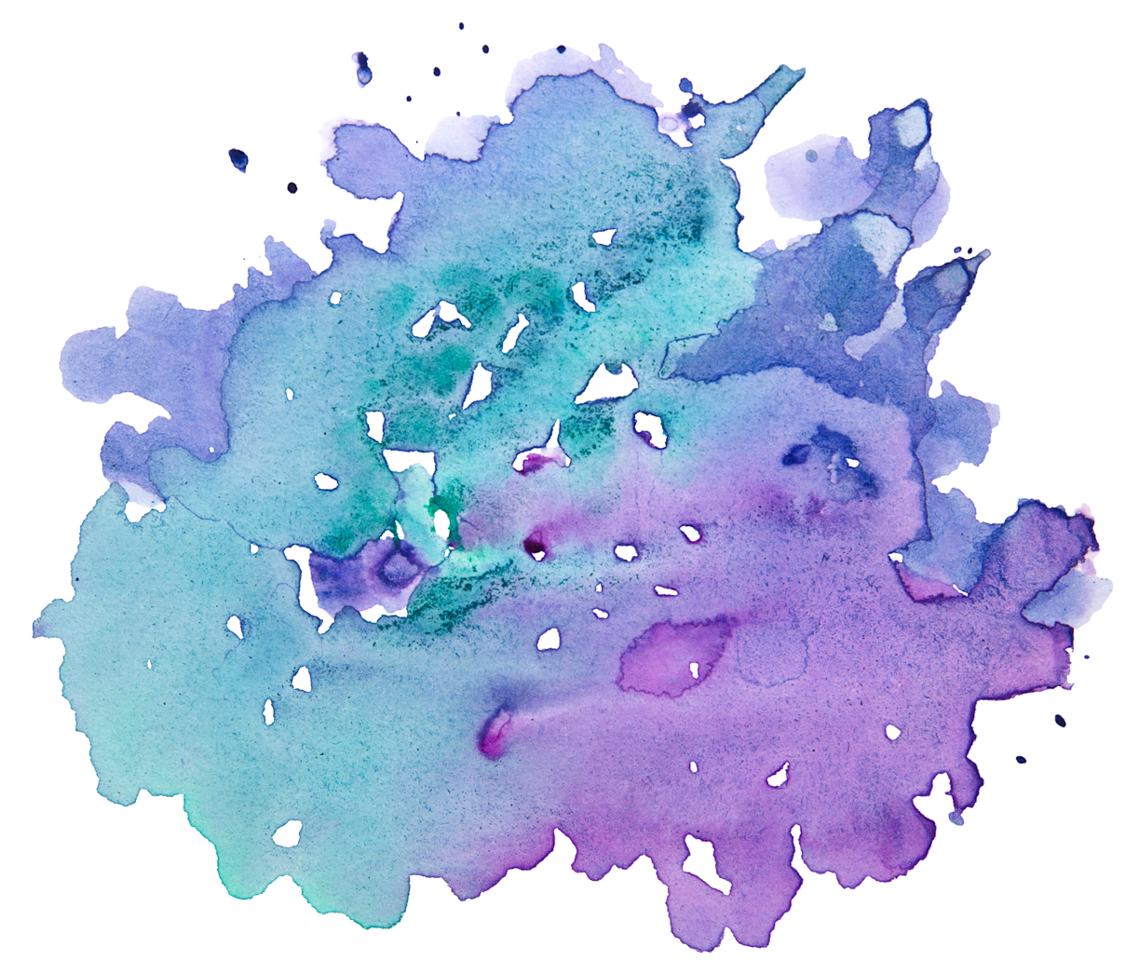
This work:
More than 25% of all MAC operations are redundant
Can we utilize this to save power?
Notes:
AlexNet, CIFAR10, stems from out statistics.

Slide 9

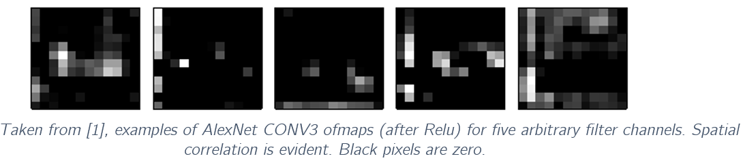

Core Ideas
Relu is common: Due to its relative simplicity and fast convergence rate, Relu is currently the most popular activation method
Spatial Correlation: There is a large correlation between nearby pixels
Non-positive convolution values turn zeros: Relu thresholds any negative values to 0

Slide 10
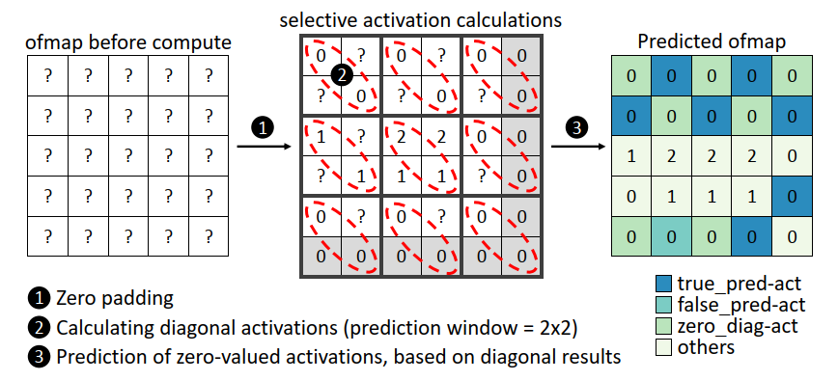
Cross Neuron Predictions
The Good:
For a good prediction, we save as many MAC operations as there are zeros in the prediction mask
The Bad: Bad predictions may degrade classification accuracy

Slide 11
Optimizing Prediction masks

Slide 12
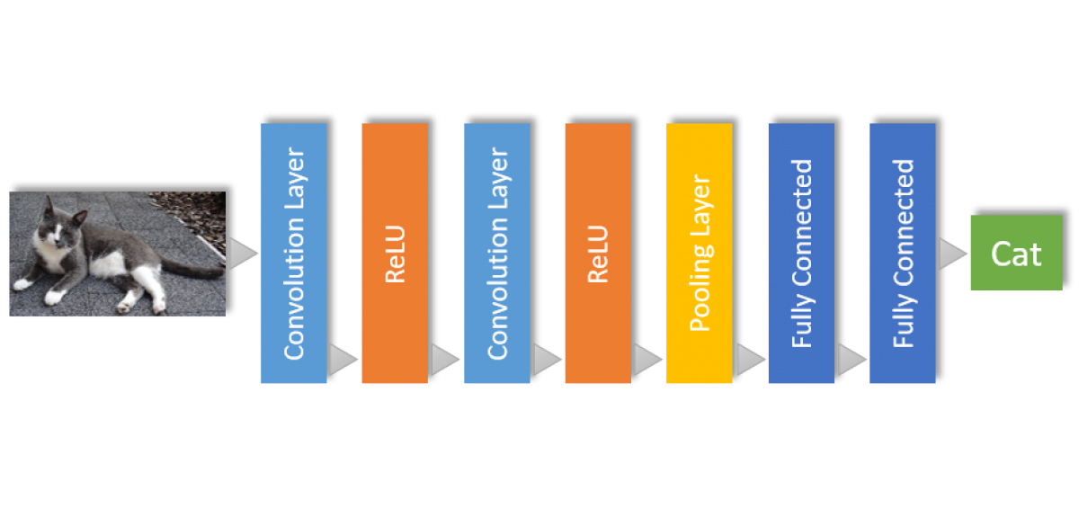

CNP Simulations
Utilizing PyTorch Layers: We create a custom “Spatial” layer, responsible for collecting MAC operation statistics with each forward run of the CNN. These layers are placed after Conv & Relu layers
Spatial
Spatial

Slide 13
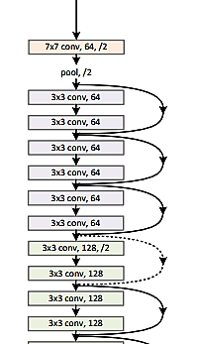
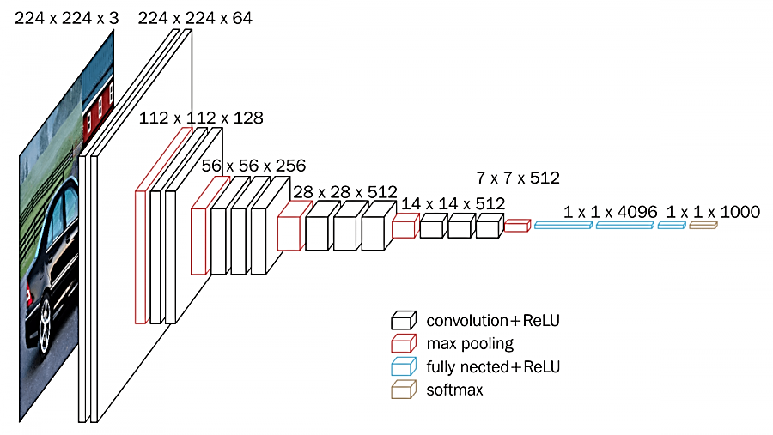
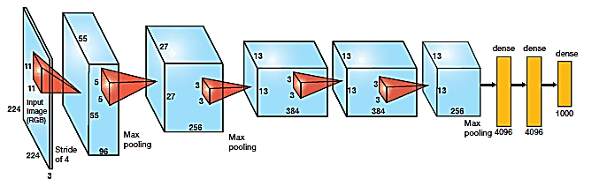
CNP Simulations
Generalizing to other architectures: We allow generalization of CNP testing to any network architecture with the SpatialNet class family, and implement for AlexNet, ResNet18, ResNet34 and VGG16

Slide 14
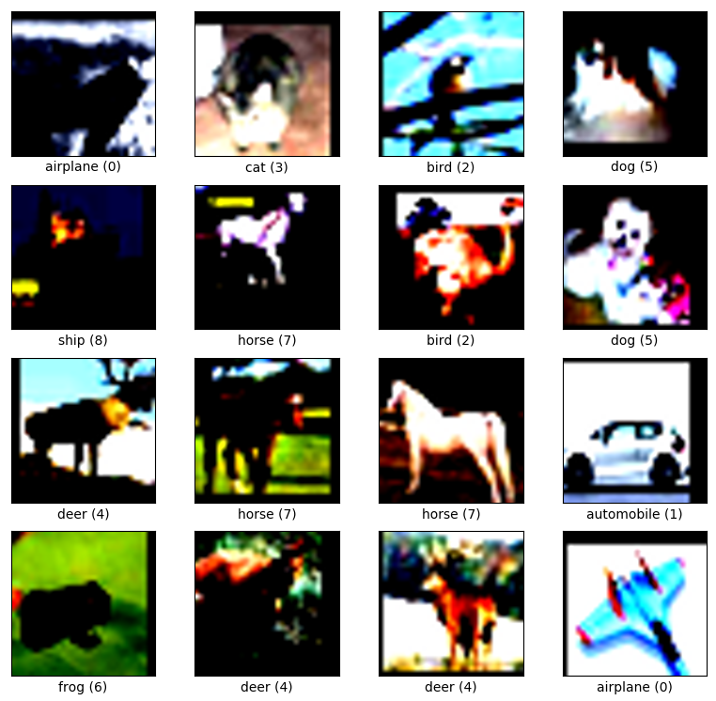
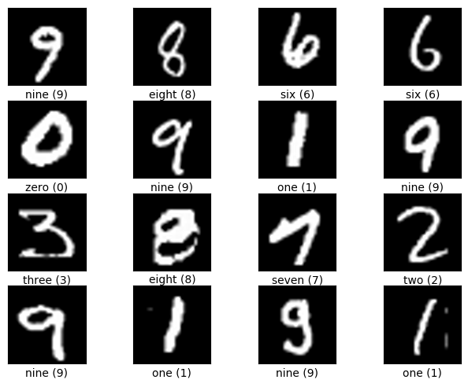
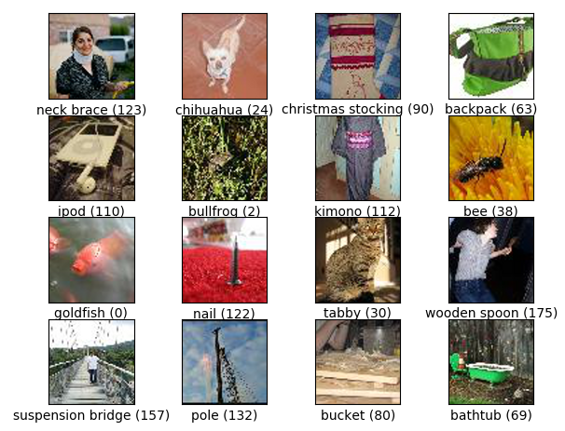
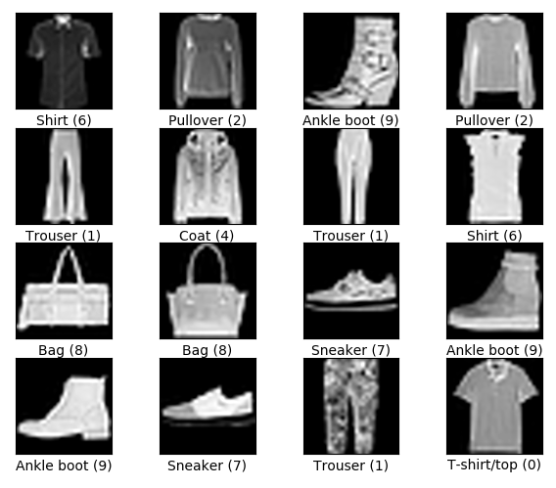
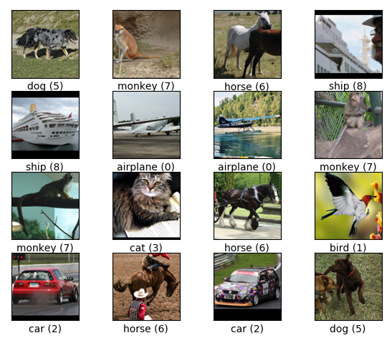
CNP Simulations
Dataset Generality: Input layers, output and fully connected layers are tailored to a specific dataset. We embed flexibility in the network build phase, allowing for testing on any dataset chosen
CIFAR10,
32x32 RGB
MNIST,
28x28 Grey
ImgNet,
256x256 RGB
FashionMNIST,
28x28 Grey
STL10,
96x96 RGB

Slide 15
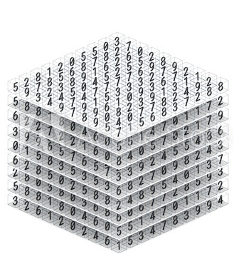
Optimization Troubles
First layer of AlexNet has 96 filters of size 11x11
With an input size of 227x227, we receive a 96x55x55 ofmap, which will be inserted to the Spatial layer.
With a patch size of 2x2, we split the map into 2x2 blocks. We zero-pad to 96x56x56 and we receive N slots where:
We now have different mask configurations to choose from, making this problem incomputable and most likely, NP-Hard
Example of an output feature map
(ofmap)
Notes:
And this is only for the first layer. Explain that each configuration needs a +1ms forward run to calculate the op savings + current accuracy.

Slide 16

Greedy Optimizations
How can we escape a combinatorial explosion?

Slide 17
Core Presumption
Inna Inna Inna

Slide 18
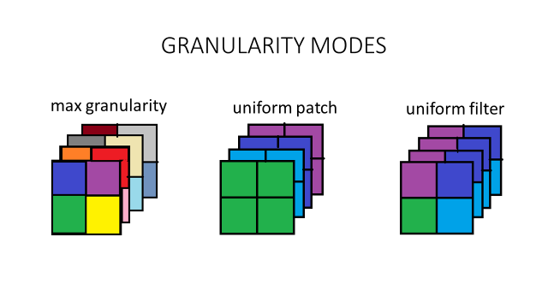
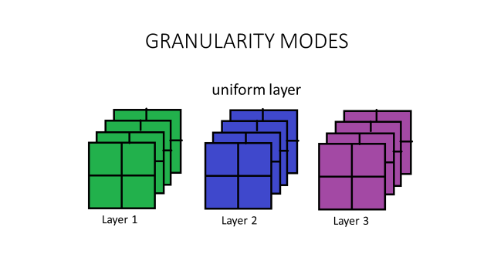
Greedy Optimization
We devise a Greedy optimization scheme, running in 4 modes of Granularity

Slide 19
Hyper-parameters
Network
Dataset
Optimization Mode
Inna Inna Inna
Inna Inna Inna
Inna Inna Inna
AcceptableError Rate
Ones Range
Granularity Thrershold
Inna Inna Inna
Inna Inna Inna
Inna Inna Inna

Slide 21
Five Features
Your great subtitle goes here
PICTURES
PICTURES
PICTURES
PICTURES
PICTURES
Buying and selling a product lorem service.
Buying and selling a product lorem service.
Buying and selling a product lorem service.
Buying and selling a product lorem service.
Buying and selling a product lorem service.
Our description
The activities of a company associated with buying and selling a product or service that includes advertising, selling items and delivering products to people who work on social media market this activities of a company associated with buying and selling a product or service that includes advertising.

Slide 22
Cycle Infographic
Your great subtitle goes here
STRATEGY 01
STRATEGY 02
People who work in marketing try to get the attention.
People who work in marketing try to get the attention.
STRATEGY 03
STRATEGY 04
People who work in marketing try to get the attention.
People who work in marketing try to get the attention.

Slide 23
What We Do?
Your great subtitle goes here
Live Chat
Documents
People who work in marketing try to get the attention of target.
People who work in marketing try to get the attention of target.
Level 1
Level 2
Level 3
Level 4
Great Tools
Fast Delivery
People who work in marketing try to get the attention of target.
People who work in marketing try to get the attention of target.

Slide 25

Results

Slide 26
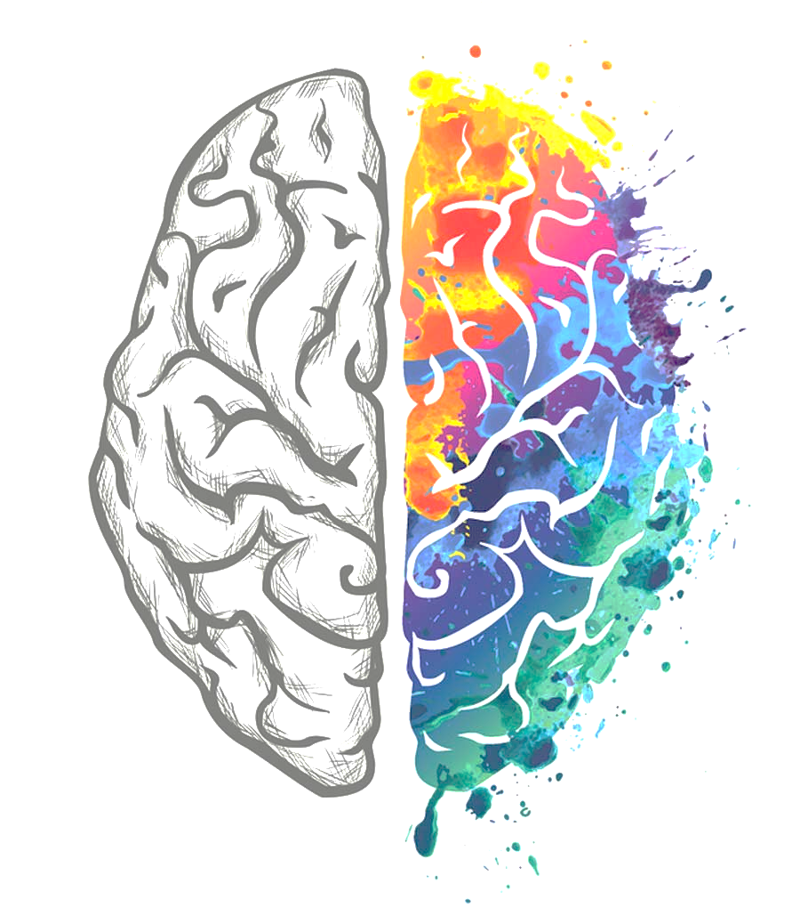
AlexNet, CIFAR10, 5 Spatial layers
Network was trained to a 75.8% 1-0 classification accuracy on CIFAR10 (10 classes).
We test our various optimization modes in contrast to the baseline result of all diagonal uniform network mask.
We receive a 14.1% decrease in accuracy, with 34% MAC operations saved for this configuration.

Slide 32
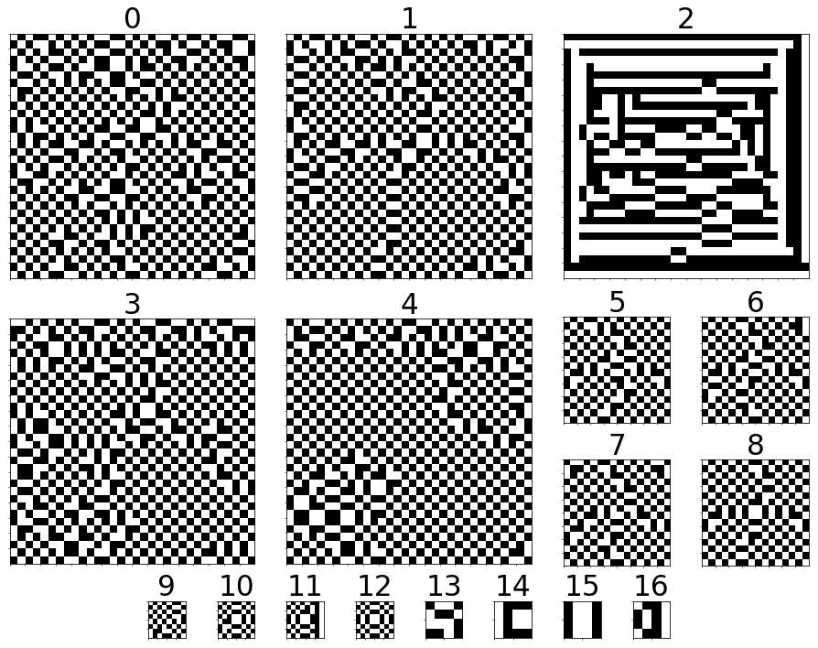

Slide 33
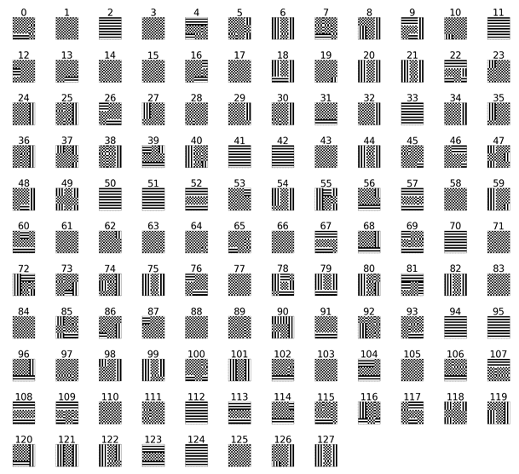

Slide 34
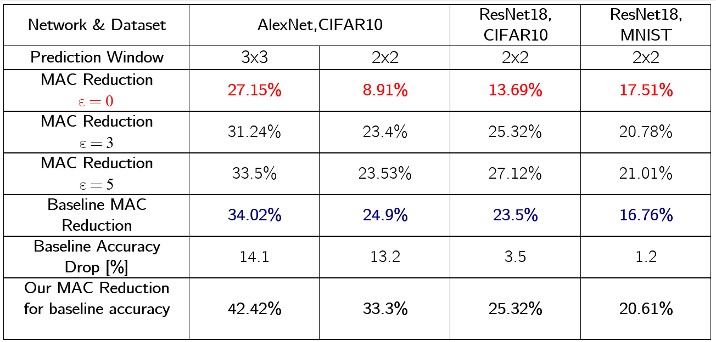

Slide 35
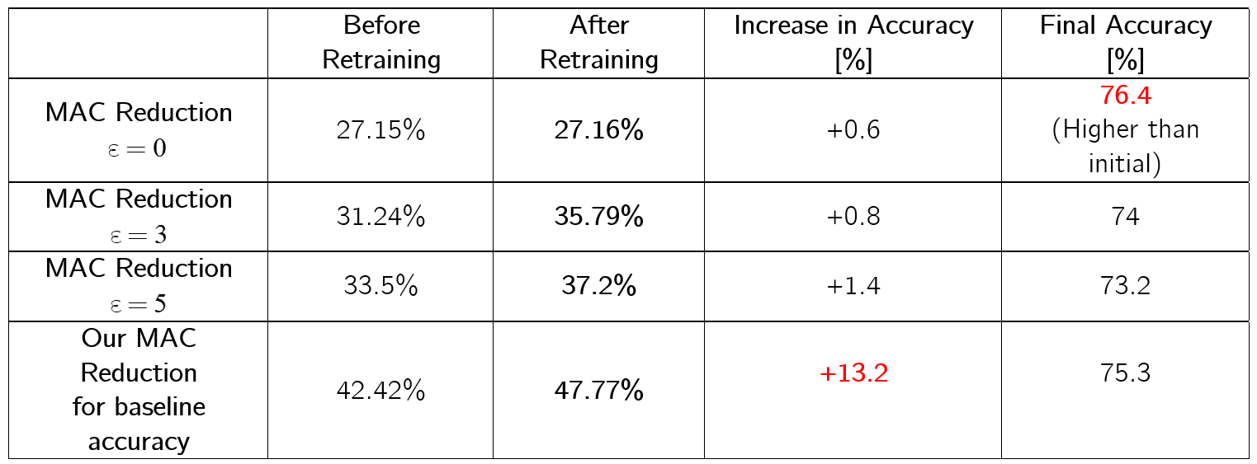

Slide 36

Tables to compare data

Slide 37
Use Charts to
Present data
86%
59%
50%
37%
Q1
Q2
Q3
Q4

Slide 38

Summary
We
Love
Optimizations

Slide 39


